Slide 1
BANKING AND ATM NETWORK in CISCO PACKET TRACER
By:
Prajneet Singh Ruprai

Slide 2
What is a network ?
A network consists of two or more computers that are linked in order to share resources (such as printers and CD-ROMs), exchange files, or allow electronic communications. The computers on a network may be linked through cables, telephone lines, radio waves, satellites, or infrared light beams.
The three basic types of networks include:
1) Local Area Network (LAN)
2)Metropolitan Area Network (MAN)
3) Wide Area Network (WAN)

Slide 3
Local Area Network (LAN)
In a typical LAN configuration, one computer is designated as the file server. It stores all of the software that controls the network, as well as the software that can be shared by the computers attached to the network. Computers connected to the file server are called workstations. The workstations can be less powerful than the file server, and they may have additional software on their hard drives.
On most LANs, cables are used to connect the network interface cards in each computer.

Slide 4
Metropolitan Area Network (MAN)
A Metropolitan Area Network (MAN) covers larger geographic areas, such as cities or school districts. By interconnecting smaller networks within a large geographic area, information is easily disseminated throughout the network. Local libraries and government agencies often use a MAN to connect to citizens and private industries.

Slide 5
Wide Area Network (WAN)
A wide area network (WAN) is a geographically distributed private telecommunications network that interconnects multiple local area networks (LANs). In an enterprise, a WAN may consist of connections to a company's headquarters, branch offices, colocation facilities, cloud services and other facilities. Typically, a router or other multifunction device is used to connect a LAN to a WAN. Enterprise WANs allow users to share access to applications, services and other centrally located resources. This eliminates the need to install the same application server, firewall or other resource in multiple locations

Slide 6
Types Of Network Used In Banks
Core Banking Solution (CBS) is networking of branches, which enables Customers to operate their accounts, and avail banking services from any branch of the Bank on CBS network, regardless of where he maintains his account.
Core Banking Solution is the process of providing a centralized on-line system where all the data related to transactions, customer data (such as name, profession, income, family members, etc.) are stored and are available to all networked branches for access.
CBS has Regional cluster center, which connects all the banks in a particular area, which gets connection in higher bandwidths from each branch. The banks server are connected to this RCC, thereby their operations are interlinked.

Slide 7
About the project
The following case study is used to illustrate the process and documentation
required for a network design. This case study presents a scenario in which
the Banks & ATM has hired a Network Consultant Group to design their
network. In order to help organization this project, the scenario has been
broken into eight phases listing requirements for each phase. A worksheet is
to be completed for each part. A formal report, similar to what would be
given to the banks, will need to be created after all tasks have been
completed.

Slide 8
Steps to be accomplished
Use the resources provided, diagram and narrative, to set up the physical network.
Set up an IP subnetting scheme.
Configure the routers as required.
Set up switches and VLANs as required.
Verify and troubleshoot all connections.
Provide detailed documentation in appropriate form.
Provide a written final report.

Slide 9
About the technology of the project
Cisco Certified Network Associate (CCNA®) validates the ability to install, configure, operate, and troubleshoot medium-size route and switched networks, including implementation and verification of connections to remote sites in a WAN. CCNA curriculum includes basic mitigation of security threats, introduction to wireless networking concepts and terminology, and performance-based skills.

Slide 10
Cisco Packet Tracer
Cisco Packet Tracer is a cross-platform visual simulation tool designed by Cisco Systems that allows users to create network topologies and imitate modern computer networks.
The software allows users to simulate the configuration of Cisco routers and switches using a simulated command line interface.
Packet Tracer makes use of a drag and drop user interface, allowing users to add and remove simulated network devices as they see fit.
The software is mainly focused towards Certified Cisco Network Associate Academy students as an educational tool for helping them learn fundamental CCNA concepts.

Slide 11
Why do we need packet tracers?
Packet Tracer allows students to design complex and large networks, which is often not feasible with physical hardware, due to costs. Packet Tracer is commonly used by CCNA Academy students, since it is available to them for free. However, due to functional limitations, it is intended by CISCO to be used only as a learning aid, not a replacement for Cisco routers and switches. The application itself only has a small number of features found within the actual hardware running a current Cisco IOS version. Thus, Packet Tracer is unsuitable for modelling production networks. It has a limited command set, meaning it is not possible to practice all of the IOS commands that might be required.

Slide 12
SUMMARIZING the First Defense Work
Designed the scenario using different components and
services:
Server
Router(wireless also)
Cloud
PCs and switches
for North and South banking network with ATM and control
router for each bank.

Slide 13
Configuring the Routers and PCs
Configure the Serial Interfaces of the Router with classless IP addresses
Configure the PCs with classless IP addresses in static and dynamic mode.
Configure the Routers with OSPF configuration for inter-network communication.

Slide 14
Configure the wireless routers
Wireless routers can be configured different modes:-
PPPoE
Automatic
Static
Wireless interface is use for connection between pc and
router using a key service and using a key password.

Slide 15
Configuring the server
HTTP service is configure in server by using selecting HTTP option from the server config menu and writing the HTML code to be displyed.
For DNS service:-Server is configure for DNS service by selecting DNS option from config menu of the server and then adding the resource records with their corresponding IP addresses.

Slide 16
Future Scope
To configure the cloud service that connects the 2 networks namely north banking and south banking using frame relay.
To configure the server for FTP services.
Add more security features.

Slide 17
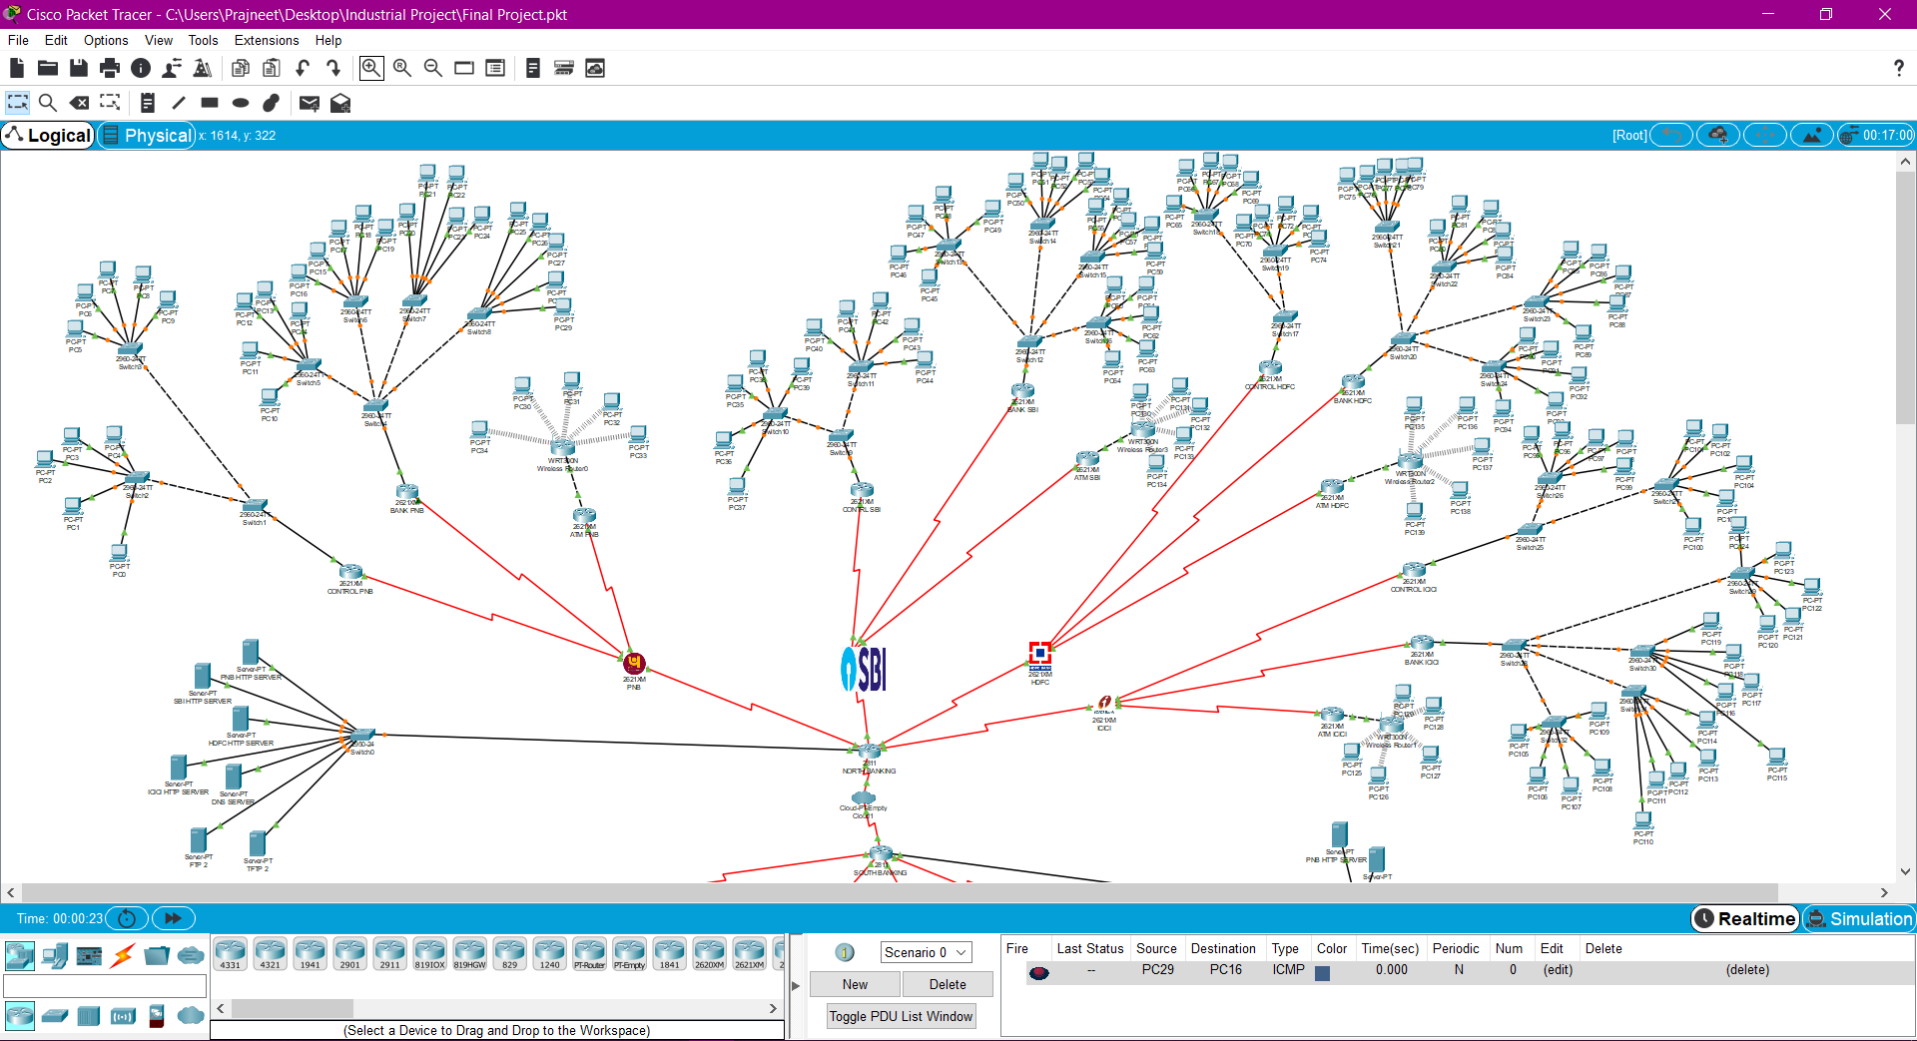
Structure of the network

Slide 18
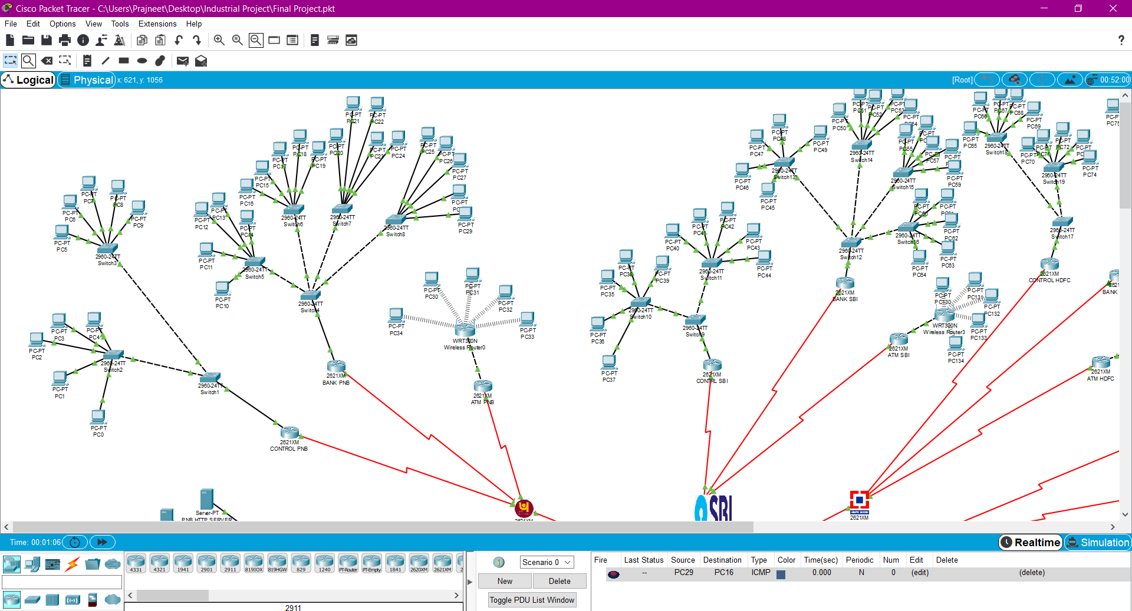
Contd.

Slide 19
References
https://www.cisco.com/web/ANZ/cpp/refguide/hview/router/3600.html
https://www.geeksforgeeks.org/cisco-router-modes/
https://www.cisco.com/c/en/us/td/docs/routers/access/800M/software/800MSCG/routconf.html
https://www.cisco.com/c/en_in/products/switches/index.html

Slide 20
THANK YOU

